Slide 1
MALLA REDDY UNIVERSITY
MR22-1CS0141:
DESIGN AND ANALYSIS OF ALGORITHMS
II YEAR B.TECH. (CSE) / I - SEM
(MRU - R22)
UNIT-III

Slide 2
UNIT- III
Greedy method:
General method - Greedy algorithm, Example, Components of Greedy Algorithm, Applications of Greedy method - Job sequencing with deadlines- Greedy Job Algorithm, Knapsack problem- Greedy Knapsack algorithm - Fractional Knapsack problem, Spanning trees, Minimum cost spanning trees(MST)-Types of MST- Prim’s Algorithm, Kruskal’s Algorithm, Single source shortest path problem- DIJKSTRA’S Algorithm.

Slide 3
Greedy method
Greedy is the most straight forward design technique used to solve the problems.
a simple strategy of progressively building up a solution, one element at a time, by choosing the best possible element at each stage.
This method is used for solving “optimization problems”.
An optimization problem is a problem which requires either minimum or maximum results.
The optimal solution is the solution which is the best and the most favorable solution in the subset.
Two paradigms:
Subset paradigm
Ordering paradigm

Slide 4
Greedy method
Subset paradigm:
algorithms that generate sub-optimal solutions
Example:
Knapsack, Job sequencing with deadlines and minimum cost spanning trees
Ordering paradigm:
make decisions by considering the inputs in some order
each decision is made using an optimization criterion that can be computed using decisions already made
Example:
optimal storage on tapes, optimal merge patterns and single source shortest path

Slide 5
Greedy method
Steps for Creating a Greedy Algorithm:
By following the steps given below, you will be able to formulate a greedy solution for
the given problem statement:
Step 1: In a given problem, find the best substructure or subproblem.
Step 2: Determine what the solution will include (e.g., maximum profit, shortest
path).
Step 3: Create an iterative process for going over all subproblems and creating an
optimum solution.

Slide 6
Pseudocode for Greedy method
Algorithm Greedy (a, n) // a(1 : n) contains the ‘n’ inputs
{
solution := Φ; // initialize the solution to empty
for i:=1 to n do
{
x := select (a);
if feasible (solution, x) then
solution := Union (Solution, x);
}
return solution;
}

Slide 7
Applications of Greedy method
It is used in a job sequencing with a deadline.
This algorithm is also used to solve the fractional knapsack problem.
It is used to find the minimum spanning tree using the prim's algorithm or the Kruskal's algorithm.
It is used in finding the shortest path.

Slide 8
JOB SEQUENCING WITH DEADLINES
We are given a set of ‘n’ jobs, associated with each Job i, deadline di > 0 and profit Pi > 0
For any job ‘i’ the profit pi is earned iff the job is completed by its deadline.
Only one machine is available for processing jobs.
An optimal solution is the feasible solution with maximum profit.
Sort the jobs in ‘j’ ordered by their deadlines.
The array d [1 : n] is used to store the deadlines of the order of their p-values.
The set of jobs j [1 : k] such that j [r], 1 ≤ r ≤ k are the jobs in ‘j’ and d (j [1]) ≤ d (j[2]) ≤ . . . ≤ d (j[k]).
To test whether J U {i} is feasible, we have just to insert i into J preserving the deadline ordering and then verify that d [J[r]] ≤ r, 1 ≤ r ≤ k+1.

Slide 9
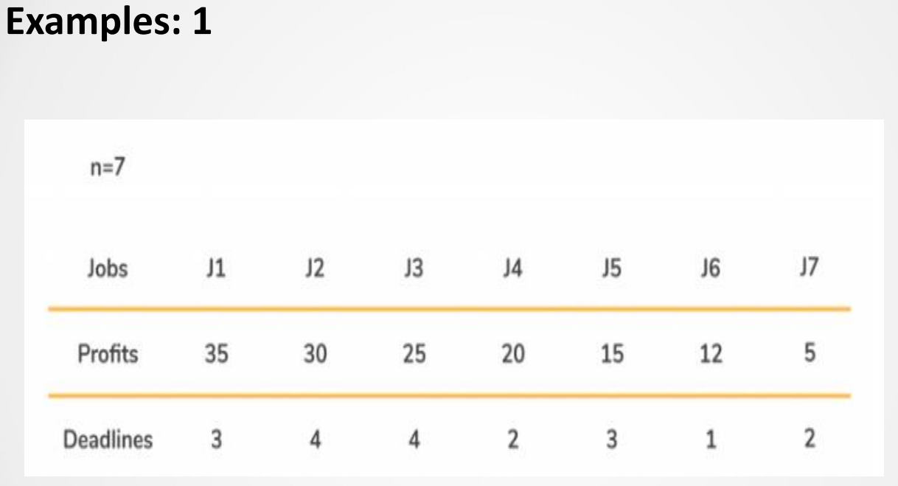
JOB SEQUENCING WITH DEADLINES

Slide 10
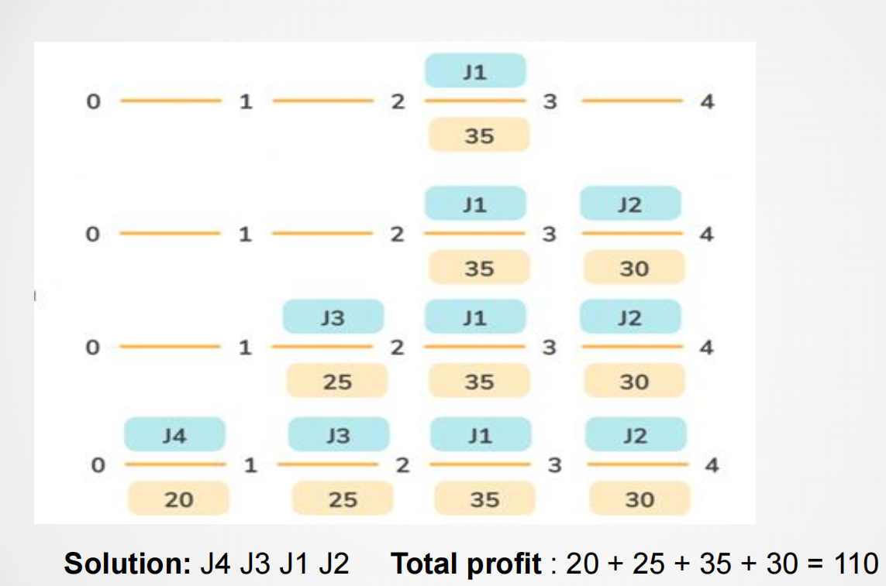
JOB SEQUENCING WITH DEADLINES

Slide 11
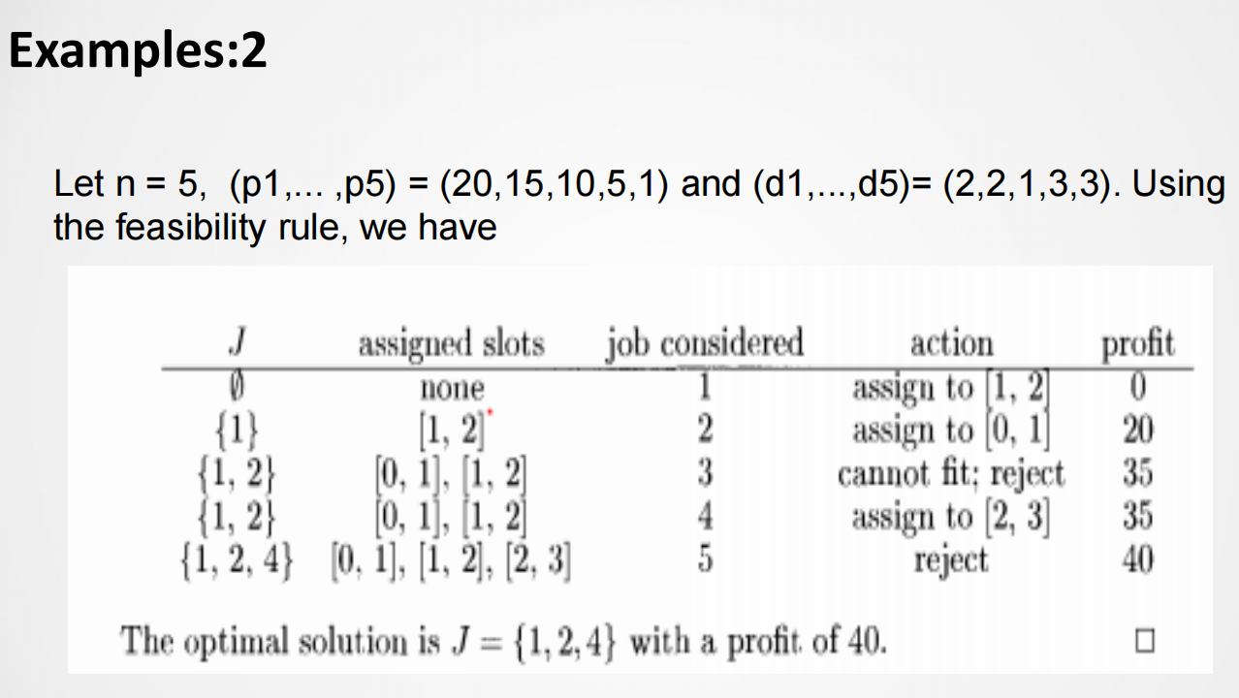
JOB SEQUENCING WITH DEADLINES

Slide 12
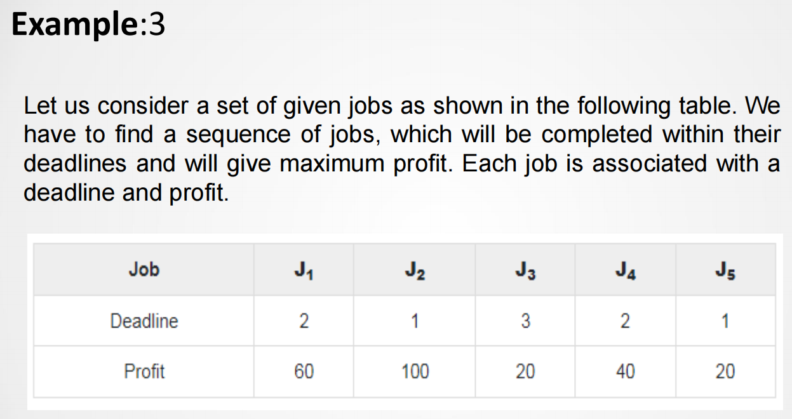
JOB SEQUENCING WITH DEADLINES

Slide 13
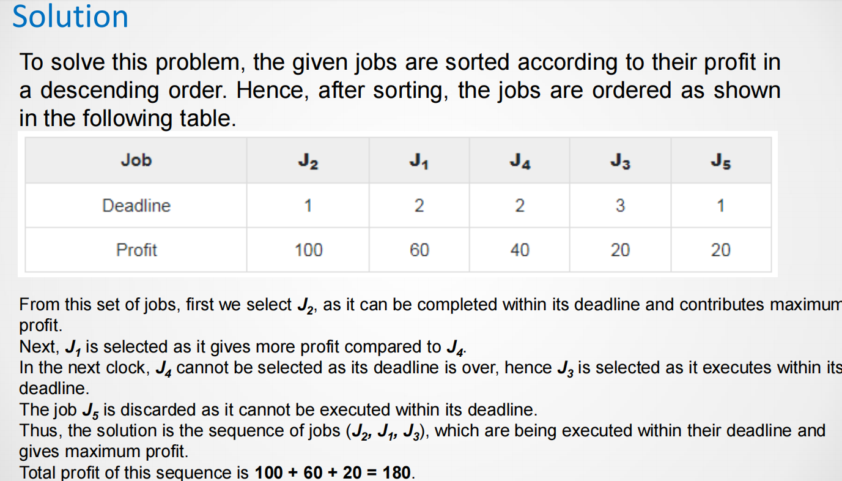
JOB SEQUENCING WITH DEADLINES

Slide 14
JOB SEQUENCING WITH DEADLINES
Algorithm GreedyJob (d, J, n)
// J is a set of jobs that can be completed by their deadlines.
{
J := {1};
for i := 2 to n do
{
if (all jobs in J U {i} can be completed by their dead lines)
then J := J U {i};
}
}

Slide 15
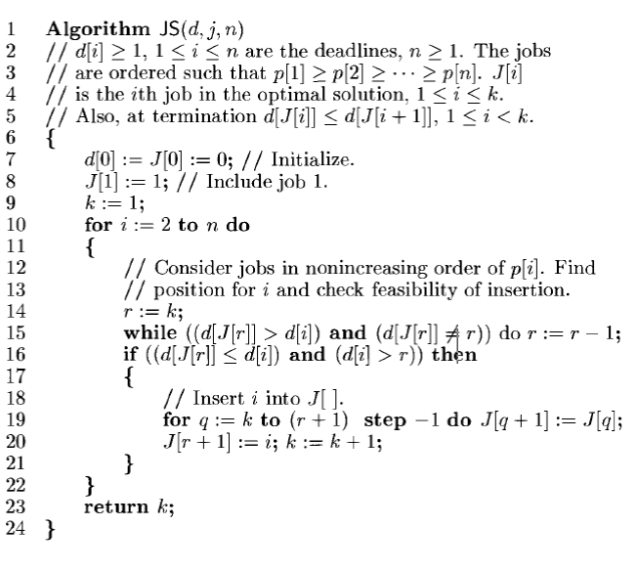

Slide 16
JOB SEQUENCING WITH DEADLINES
Time Complexity:
1. Sort job according to decresing order of deadline = O(nlogn)
2. for each job find slot in array of size n = O(n²)
Total time complexity = O(nlogn) + O(n²)
=O(n²)

Slide 17
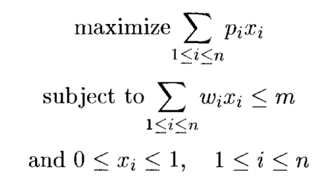
Knapsack Problem
We are given ‘n’ objects and a knapsack.
The object ‘i’ has a weight wi and the knapsack has a capacity ‘m’.
If a fraction xi, 0 < xi < 1 of object i is placed into the knapsack then a profit of pi xi is earned.
The objective is to fill the knapsack that maximizes the total profit earned.
Since the knapsack capacity is ‘m’, we require the total weight of all chosen objects to be at most ‘m’.
The problem is stated as,

Slide 18
Knapsack Problem
Example 1:
Consider the following instance of the knapsack problem and obtain the optimal solution:
Capacity of Knapsack M = 40,
Number of objects n = 3,
Profits of the objects (p1, p2, p3) = (30, 40, 35)
Weights of the objects (w1, w2, w3) = (20, 25, 10)
Step 1: Find the profit and weight ratio i.e pi / wi
Object | 1 | 2 | 3
Profit | 30 | 40 | 35
Weight | 20 | 25 | 10
Pi / wi | 1.5 | 1.6 | 3.5

Slide 19
Knapsack Problem
Step 2: Arrange objects in decreasing order of ratio pi / wi
Step 3: Compute the profit : Total Profit: 82.5
Object | 1 | 2 | 3
Profit | 35 | 40 | 30
Weight | 10 | 25 | 20
Pi / wi | 3.5 | 1.6 | 1.5
Object | pi | wi | x | M=M-wi * x | Profit= pi * x
1 | 35 | 10 | Check 10<40 Is True, x=1 | M=40-10*1 =30 | 35*1=35
2 | 40 | 25 | Check 25<30 Is True, x=1 | M=30-25*1 =5 | 40*1=40
3 | 30 | 20 | Check 20<5 Is False, x=M/wi = 5/20 | M=5-20*0.25 | 30*0.25=7.5

Slide 20
Knapsack Problem
Example 2:
Consider the following instance of the knapsack problem: n = 3, m = 20,
(p1, p2, p3) = (25, 24, 15) and (w1, w2, w3) = (18, 15, 10)
Profit=31.5
Example 3:
Consider the following instance of the knapsack problem: n = 7, m = 15,
(p1, p2, p3,p4,p5,p6,p7) = (10, 5, 15, 7, 6, 18, 3) and
(w1, w2, w3,w4,w5,w6,w7) = (2, 3, 5, 7, 1, 4, 1)
Profit=55.33

Slide 21
Knapsack Problem
Algorithm GreedyKnapsack (m, n)
// P[1 : n] and w[1 : n] contain the profits and weights respectively of
// Objects ordered so that p[i] / w[i]> p[i + 1] / w[i + 1].
// m is the knapsack size and x[1: n] is the solution vector.
{
for i := 1 to n do x[i] := 0.0 // initialize x
U := m;
for i := 1 to n do
{
if (w(i) > U) then break;
x [i] := 1.0; U := U – w[i];
}
if (i < n) then x[i] := U / w[i];
}

Slide 22
Minimum Spanning Trees (MST)
A spanning tree with the smallest possible weight.
has a minimum cost among all the spanning trees.
The cost of the spanning tree is the sum of the weights of all the edges in the tree.
In real-life situations, this weight can be measured as distance, cost of transportation, manufacturing cost, traffic load, or any arbitrary value denoted by the edges.
A minimum spanning tree has (V – 1) edges, where V is the number of vertices in the given graph

Slide 23
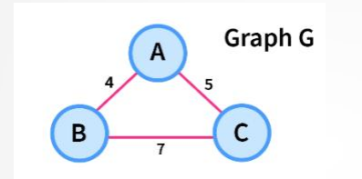
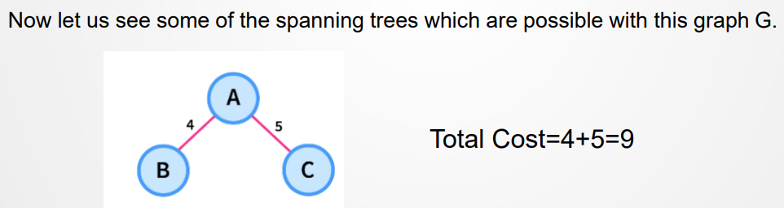
Minimum Spanning Trees (MST)
Example:
Consider a weighted graph G with three vertices as shown in the picture below.

Slide 24
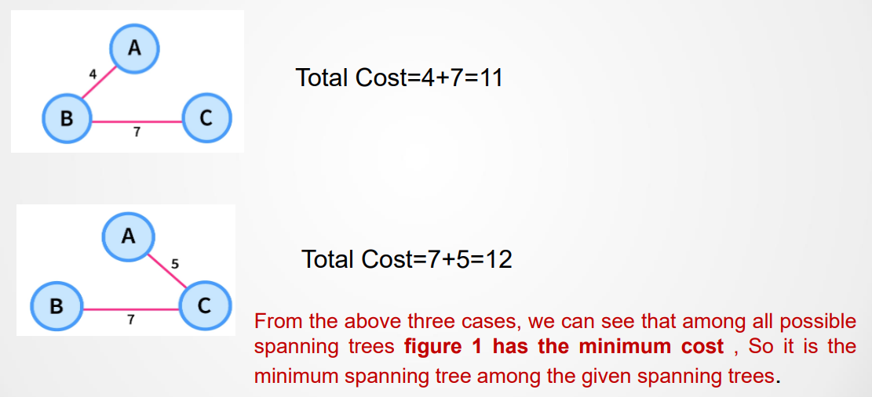
Minimum Spanning Trees (MST)

Slide 25
Minimum Spanning Trees (MST)
Applications of Minimum Spanning Tree:
Minimum Spanning Tree is used for designing telecommunication networks and water supply networks.
For designing Local Area Networks.
For solving the Travelling salesman problem.
Two algorithms to find Minimum Spanning Tree:
1. Kruskal’s algorithm - uses edges
2. Prim’s algorithm - uses vertex connections

Slide 26
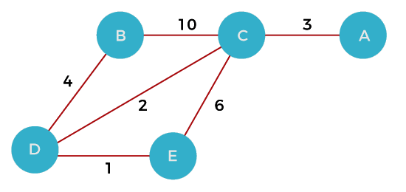
Prim’s Algorithm
find the minimum spanning tree from a graph
Starts with the single node and explores all the adjacent nodes
The edges with the minimal weights causing no cycles in the graph got selected

Slide 27
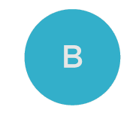
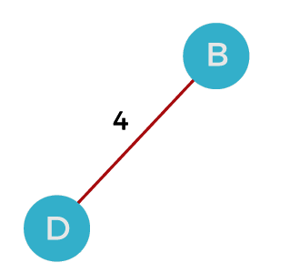
Prim’s Algorithm
Step 1 - First, choose a vertex from the graph. Let's choose B.
Step 2 - Now, choose and add the shortest edge from vertex B. There are two edges from vertex B. Among the edges, the edge BD has the minimum weight. So, add it to the MST.

Slide 28
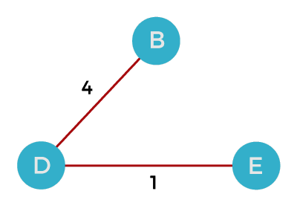
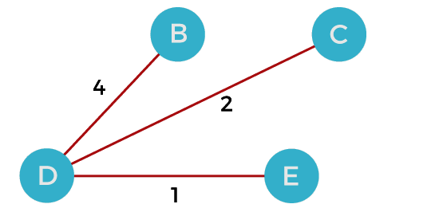
Prim’s Algorithm
Step 3 - Now, again, from D choose the edge with the minimum weight among all the other edges. So, select the edge DE and add it to the MST.
Step 4 - Now, select the edge CD, and add it to the MST.

Slide 29
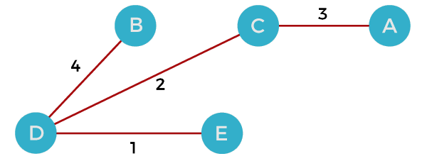
Prim’s Algorithm
Step 5 - Now, choose the edge CA. Here, we cannot select the edge CE as it would create a cycle to the graph. So, choose the edge CA and add it to the MST.
So, the graph produced in step 5 is the minimum spanning tree of the given graph.
Cost of MST = 4 + 2 + 1 + 3 = 10 units.

Slide 30
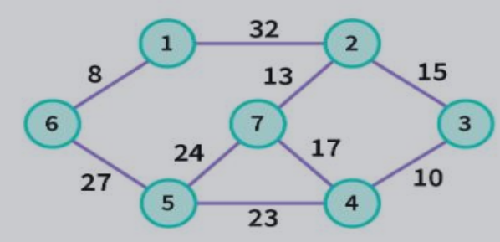
Example - Prim’s Algorithm

Slide 31
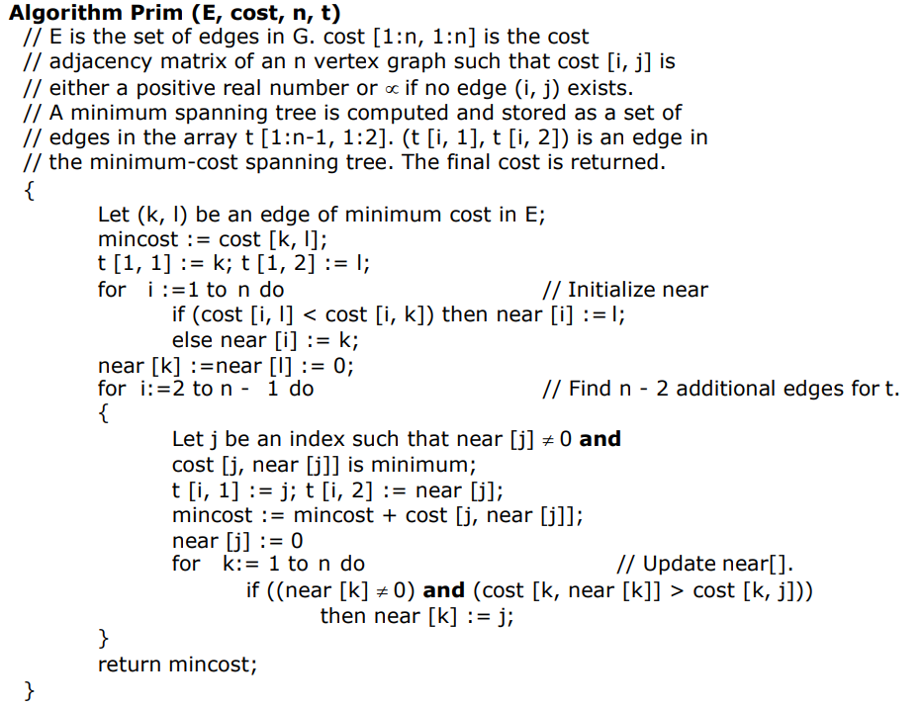
Prim’s Algorithm

Slide 32
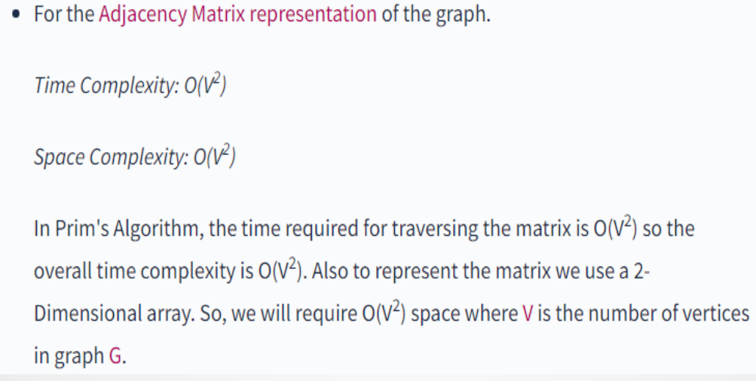
Prim’s Algorithm

Slide 33
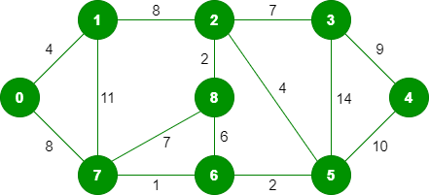
Kruskal’s Algorithm
A minimum spanning tree has (V – 1) edges where V is the number of vertices in the given graph.
Algorithm:
Sort all the edges in non-decreasing order of their weight.
Pick the smallest edge. Check if it forms a cycle with the spanning tree formed so far. If cycle is not formed, include this edge. Else, discard it.
Repeat step#2 until there are (V-1) edges in the spanning tree.
The graph contains 9 vertices and 14 edges. So, the minimum spanning tree formed will be having (9 – 1) = 8 edges.

Slide 34
Kruskal’s Algorithm
After sorting:
Weight Src Dest
1 7 6
2 8 2
2 6 5
4 0 1
4 2 5
6 8 6
7 2 3
7 7 8
8 0 7
8 1 2
9 3 4
10 5 4
11 1 7
3 5

Slide 35

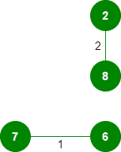
Kruskal’s Algorithm
Step 1: Pick edge 7-6: No cycle is formed, include it.
Step 2: Pick edge 8-2: No cycle is formed, include it.

Slide 36
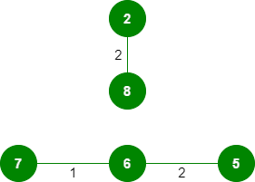
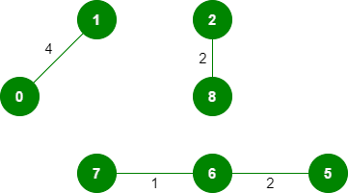
Kruskal’s Algorithm
Step 3: Pick edge 6-5: No cycle is formed, include it.
Step 4: Pick edge 0-1: No cycle is formed, include it.

Slide 37

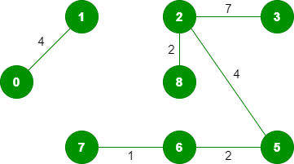
Kruskal’s Algorithm
Step 5: Pick edge 2-5: No cycle is formed, include it.
Step 6: Pick edge 8-6: Since including this edge results in the cycle, discard it. Step 7: Pick edge 2-3: No cycle is formed, include it.

Slide 38
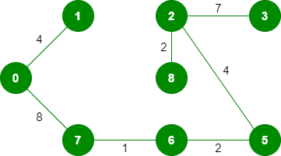
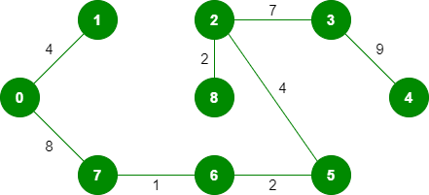
Kruskal’s Algorithm
Step 8: Pick edge 7-8: Since including this edge results in the cycle, discard it. Step 9: Pick edge 0-7: No cycle is formed, include it.
Step 10: Pick edge 1-2: Since including this edge results in the cycle, discard it. Step 11: Pick edge 3-4: No cycle is formed, include it.
Note: Since the number of edges included in the MST equals to (V – 1), so the algorithm stops here

Slide 39
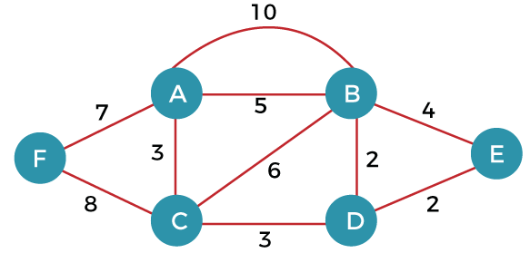
Kruskal’s Algorithm

Slide 40
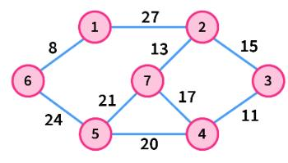
Kruskal’s Algorithm

Slide 41
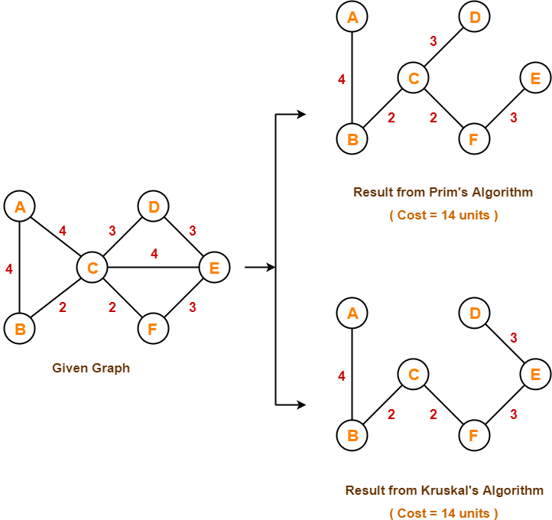
Example - Prim’s & Kruskal’s Algorithm

Slide 42
Kruskal’s algorithm
Algorithm Kruskal (E, cost, n, t)
{ //Construct a heap out of the edge costs using heapify;
for i := 1 to n do parent [i] := -1;
i := 0; mincost := 0.0;
while ((i < n -1) and (heap not empty)) do
{ Delete a minimum cost edge (u, v) from the heap and re-heapify using Adjust;
j := Find (u); k := Find (v);
if (j ≠ k) then
{ i := i + 1;
t [i, 1] := u; t [i, 2] := v;
mincost :=mincost + cost [u, v];
Union (j, k); } }
if (i ≠ n-1) then write ("no spanning tree");
else return mincost; }

Slide 43
Kruskal’s algorithm
Running time: •
The number of finds is at most 2e, and the number of unions at most n-1. Including the initialization time for the trees, this part of the algorithm has a complexity that is just slightly more than O (n + e). •
We can add at most n-1 edges to tree T. So, the total time for operations on T is O(n)
Summing up the various components of the computing times, we get O (n + e log e) as asymptotic complexity.

Slide 44
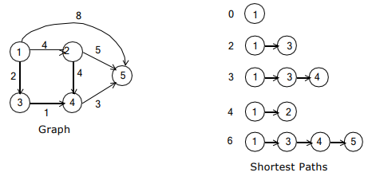
Single Source Shortest-Path Problem: DIJKSTRA'S ALGORITHM
In the single source, all destinations, shortest path problem, we must find a shortest path from a given source vertex to each of the vertices (called destinations) in the graph to which there is a path.
Dijkstra’s algorithm takes a labeled graph and a pair of vertices P and Q, and finds the shortest path between then (or one of the shortest paths) if there is more than one.
Dijkstra’s algorithm does not work for negative edges at all.

Slide 45
Dijsktra’s Algorithm
used for solving the single source shortest path problem.
computes the shortest path from one particular source node to all other remaining nodes of the graph.
works only for connected graphs and for those graphs that do not contain any negative weight edge.
only provides the value or cost of the shortest paths.
works for directed as well as undirected graphs.

Slide 46
Step-01
In the first step, two sets are defined:
One set contains all those vertices which have been included in the shortest path tree.
In the beginning, this set is empty.
Other set contains all those vertices which are still left to be included in the shortest path tree.
In the beginning, this set contains all the vertices of the given graph.

Slide 47
Step-02
For each vertex of the given graph, two variables are defined as-
Π[v] which denotes the predecessor of vertex ‘v’
d[v] which denotes the shortest path estimate of vertex ‘v’ from the source vertex.
Initially, the value of these variables is set as-
The value of variable ‘Π’ for each vertex is set to NIL i.e. Π[v] = NIL
The value of variable ‘d’ for source vertex is set to 0 i.e. d[S] = 0
The value of variable ‘d’ for remaining vertices is set to ∞ i.e. d[v] = ∞

Slide 48
Step-03
The following procedure is repeated until all the vertices of the graph are processed
Among unprocessed vertices, a vertex with minimum value of variable ‘d’ is chosen.
Its outgoing edges are relaxed.
After relaxing the edges for that vertex, the sets created in step-01 are updated.

Slide 49
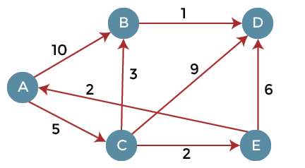
Example 1

Slide 50
A | B | C | D | E
∞ | ∞ | ∞ | ∞ | ∞
 | A | B | C | D | E
A | 0 | ∞ | ∞ | ∞ | ∞
 | A | B | C | D | E
A | 0 | ∞ | ∞ | ∞ | ∞
 |  | 10 | 5 | ∞ | ∞

Slide 51
 | A | B | C | D | E
A | 0 | ∞ | ∞ | ∞ | ∞
 |  | 10 | 5 | ∞ | ∞
 |  | 8
 | A | B | C | D | E
A | 0 | ∞ | ∞ | ∞ | ∞
C |  | 10 | 5 | ∞ | ∞
 |  | 8 |  | 14 | 7
 | A | B | C | D | E
A | 0 | ∞ | ∞ | ∞ | ∞
C |  | 10 | 5 | ∞ | ∞
E |  | 8 |  | 14 | 7

Slide 52
 | A | B | C | D | E
A | 0 | ∞ | ∞ | ∞ | ∞
C |  | 10 | 5 | ∞ | ∞
E |  | 8 |  | 14 | 7
B |  | 8 |  | 13
 | A | B | C | D | E
A | 0 | ∞ | ∞ | ∞ | ∞
C |  | 10 | 5 | ∞ | ∞
E |  | 8 |  | 14 | 7
B |  | 8 |  | 13
D |  |  |  | 9

Slide 53
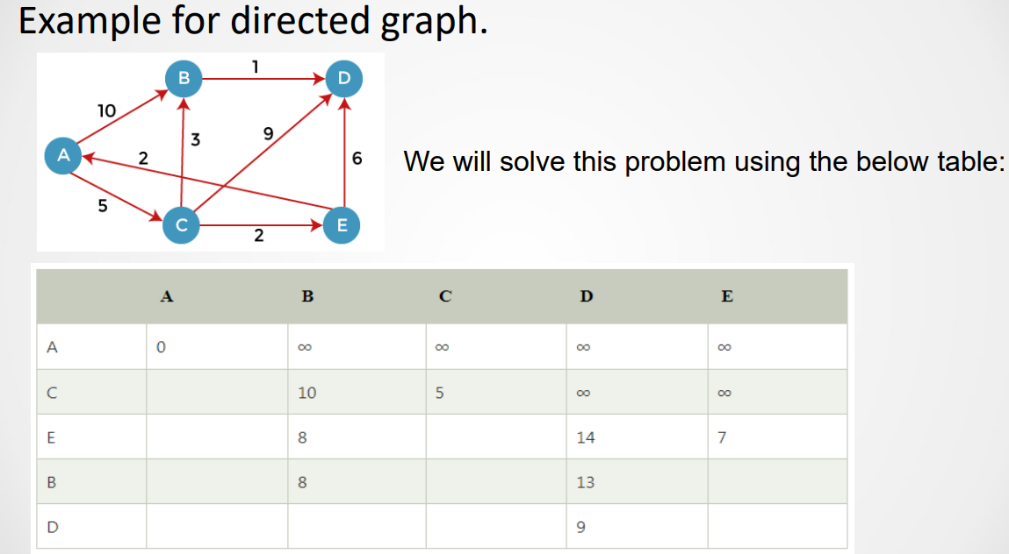
Single Source Shortest-Path Problem: DIJKSTRA'S ALGORITHM

Slide 54
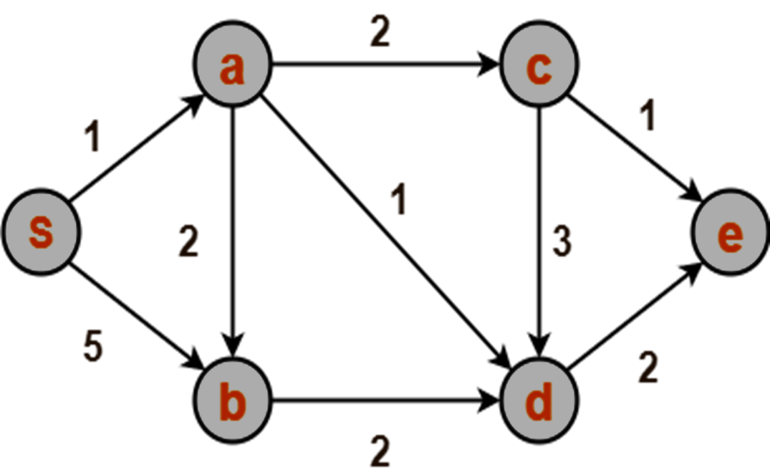
Example 2

Slide 55
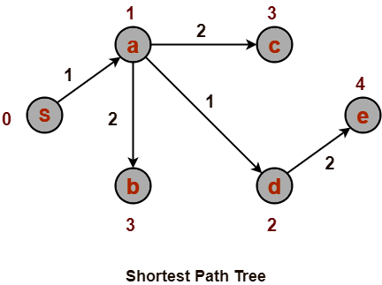
Final Shortest Path tree

Slide 56
Single Source Shortest-Path Problem: DIJKSTRA'S ALGORITHM
Algorithm Shortest-Paths (v, cost, dist, n)
{
for i :=1 to n do
{ S [i] := false;
dist [i] :=cost [v, i]; }
S[v] := true; dist[v] := 0.0; // Put v in S.
for num := 2 to n – 1 do
{ Determine n - 1 paths from v.
Choose u from among those vertices not in S such that dist[u] is minimum;
S[u] := true; // Put u is S.
for (each w adjacent to u with S [w] = false) do
if (dist [w] > (dist [u] + cost [u, w]) then // Update distances
dist [w] := dist [u] + cost [u, w]; } }

Slide 57
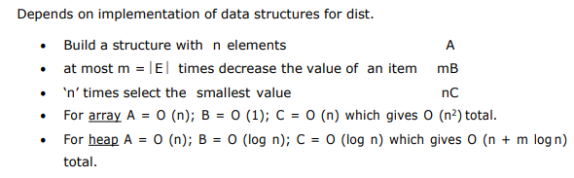
Single Source Shortest-Path Problem: DIJKSTRA'S ALGORITHM
Running time:

